Slide 1
The Bridge: A Peer Navigator Intervention for Improving the Health of Adults with Serious Mental Illness
Dr. John S. Brekke
Dr. Erin Kelly

Slide 2
To deal with the health disparities in this population we need:
Top-down: A healthcare system that is receptive and responsive
Bottom up: Consumers that are ready to be active in the system and in their own health care.

Slide 3
Peer Health Navigation Intervention: “The Bridge”
A comprehensive health care engagement and
self-management intervention

Slide 4
Comprehensive:
Connect consumers to primary care, specialty health care, and substance abuse services

Slide 5
Engagement:
Many individuals with serious mental illness are not successfully engaging a consistent primary health care provider (or a health home), or have given up trying to access and use outpatient primary care

Slide 6
Self-Management:
Train and empower consumers to be assertive self-managers of their health care so that their interactions with care providers can be more effective and consistent

Slide 7
In vivo approach
  Develops self-management skills in real world health care settings

Slide 8
Intervention Mantra
For them (modeling)
Navigator performs task,
Consumer observes
With them (coaching)
Consumer performs task,
Navigator coaches
By them (fading)
  Consumer self-manages healthcare,
  Navigator supports as needed

Slide 9
3 Phases of Intervention
Phase 1
Intensive 3 months of assessment, modeling, coaching
Phase 2
3 months of fading and consumer self-management
Phase 3
Ongoing support and boosters as needed

Slide 10
Challenge Points

Slide 11
Critical Elements of Health Navigation
Consumer Screening & Engagement
Assessment
Goal setting (Healthcare, Wellness/Lifestyle)
Preparing for the Medical Appointment
Navigating the Medical Appointment
Reviewing the Appointment
Follow up Care Plan
Self Management of Health Care

Slide 12
Peer Health Navigator Skills
Engaging and connecting with consumers
Assessment and building commitment for self management
Making a collaborative plan for the consumer’s health care based on the consumer’s goals
Accessing and utilizing health care
Modeling, coaching, fading

Slide 13
Health Navigation Skills
Consumers Develop
1. Accessing Medical Services
  Find medical services
  Access transportation
  Make and keep appointments
  2. Utilizing Medical Services
  Prepare for the medical visit
  Communicate with medical staff
  Follow treatment plan

Slide 14
3. Maintaining health
  Be organized about their health care
  Achieve Health and Wellness Goals
  Prioritize health needs
  4. Asking for support to overcome roadblocks
  5. Managing emotions and symptoms during medical activities

Slide 15
History of “Bridge”
3-year pilot research project started in 2008
Project Bridge team from the USC School of Social Work in collaboration with Pacific Clinics
Funded by:
UniHealth Foundation
NIMH
Clinical and Translational Science Institute at USC

Slide 16
Health Care Problems at
Beginning of Pilot RCT
Of 24 health problems/symptoms
Almost 100%
2+ medical problems
Over 75%
5+ medical problems
Almost 50%
10+ medical problems

Slide 17
Summary of Findings
The Peer Health Navigation Intervention (“Bridge”) shows impact and promise for:
Reducing health problems
Reducing bodily pain related to health problems
Impacting the use of medications
Shifting the locus of health care from ER and UC to outpatient primary care

Slide 18
Pilot RCT Findings
Positive findings for the intervention in terms of:
Acceptability to clients and agency staff
Tolerability for clients
Feasibility of integration into clinic and teams
Feasibility for peer providers

Slide 19
Interviews with Peer Health Navigators
People who provide critical services receive benefits themselves (the “helper principle”)
  Increased self-esteem
  Newfound confidence
  High job satisfaction
Peer Health Navigators were more likely to obtain medical care for their own health care needs after navigating consumers

Slide 20
PCORI funded Study
Brekke PI, Kelly Co-I
150 consumers have been randomized to immediate HN or 6 month wait-list
Interviews at BL and every 6 mo for 18 mo
6 months of peer health navigation
3 HNs with caseloads of about 20 each
One agency site within Pacific Clinics

Slide 21
Stages for implementing and sustaining a peer health navigator intervention at a mental health agency:
Stage 1 Prepare the agency admin. staff and supervisors
Stage 2
Train Health Navigators (using manual)
Stage 3 Integrate the intervention into the agency practices

Slide 22
Implementation Manual
With grant support from the UniHealth Foundation we are manualizing and testing the feasibility of an implementation manual for use by agency practitioners

Slide 23
Bridge Team
John Brekke, PhD, PI; USC
Lou Mallory, Peer Health Navigator Supervisor; Pacific Clinics
Erin Kelly, PhD, Co-I; USC
Heather Cohen, MPP, Project Director; USC
Laura Pancake, MSW, Corporate Director; Pacific Clinics
Holly Kiger, RN, MSN; USC
Toni Rainey, Francisco Espinoza, Tamara Ra: Peer Health Navigators; Pacific Clinics
Crystal Stewart, Jorge Avila, Research Assistants; USC

Slide 24
Systematic Review of Self-Management Interventions
Kelly, Brekke et al., Psychiatric Services, In Press
14 studies involving self-management of medical care and health by individuals with SMI
Promising evidence that consumers can collaborate with health professionals or be trained to self-manage their health and health care.
  8 of the 14 studies used a self-report measure and 5 found evidence of improvement
Evidence supports the use of mental health peers or professional staff to implement health care interventions.

Slide 25
Electronic Health Records
The federal government has recently incentivized the adoption of electronic health records (EHR)
The goal is to improve communication between mental health and medical providers
Those with SMI are often excluded from studies evaluating the effectiveness of EHR

Slide 26
Personal Health Records
Personal health records can refer to:
Records accessible to a patient but is a part of the EHR system of their medical provider
A standalone record, maintained by the patient, such as with Microsoft’s HealthVault application
Health information records accessible to a patient but maintained by a mental health agency

Slide 27
Benefits of Personal
Health Records
Could improve the efficiency and effectiveness of care
Empower individuals to become more active participants in their care
Reduce communication errors across providers
Could improve individuals’ adherence to treatment and improve their self-management of care long-term

Slide 28
Serious Mental Illness and PHR
Those with SMI are often excluded from studies about PHR
Potentially excluding a group that could derive a great deal of benefit from maintaining a PHR
  Multiple doctors
  Inconsistent insurance/access
  Poor record keeping
  Multiple chronic conditions
  Complicated treatment regimens

Slide 29
Study Overview
Phase 1: Medical providers, mental health providers, and consumers are interviewed about their perceptions of EHR and provide feedback on a PHR based out of a mental health clinic (n =25).
Phase 2: Up to 40 participants receive a modified form of the Bridge health navigator program that includes access to a PHR.

Slide 30
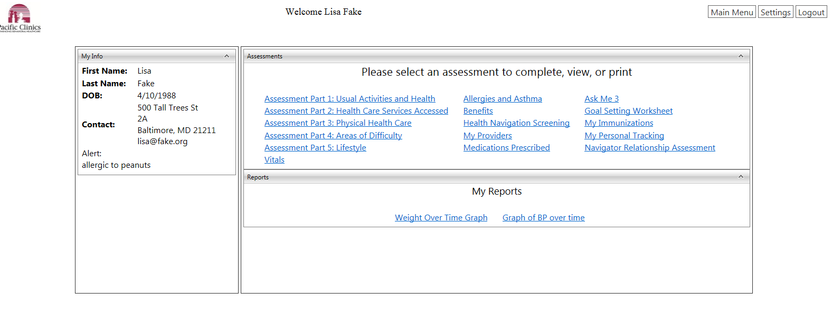
Personal Health Record

Slide 31
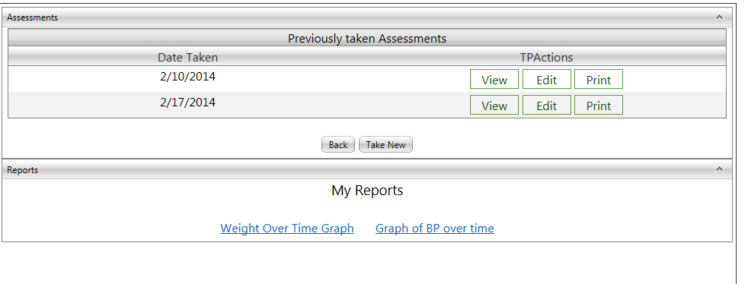
Personal Health Record

Slide 32
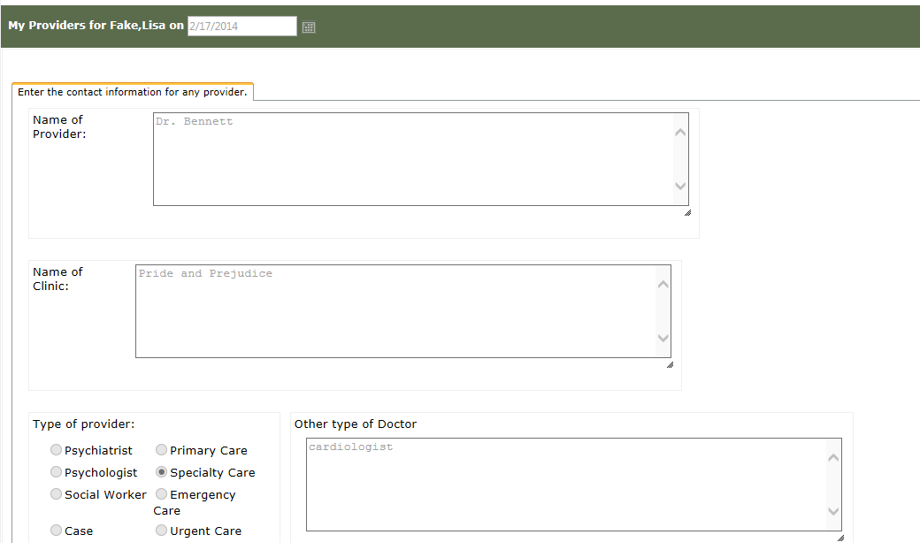
Personal Health Record

Slide 33
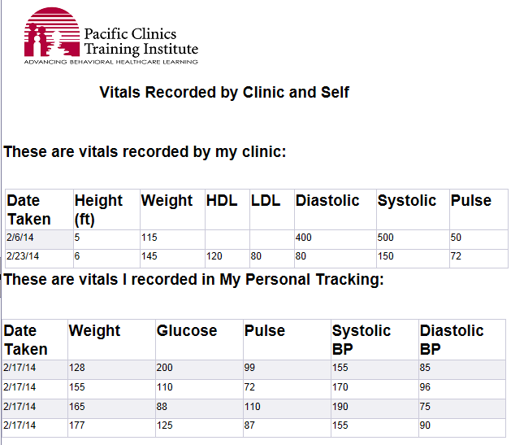
Personal Health Record

Slide 34
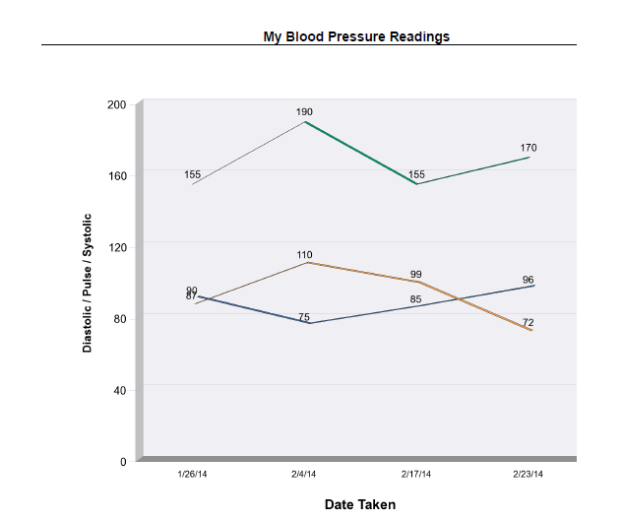
Personal Health Record

Slide 35
Preliminary Results
In the Phase 1 interviews:
  Medical providers, mental health providers, and consumers are largely enthusiastic about consumers having access to their information
  Estimates of how many consumers could use it varied considerably and was thought to depend heavily on how they were trained to use it

Slide 36
Preliminary Results
Consumers report feeling empowered
Mental health providers thought that some consumers could use the information effectively
Medical providers thought it could improve efficiency and wanted more information to assist in SSI claims, diagnostic information, medication management

